Slide 1
Html and CSS(html)

Slide 2
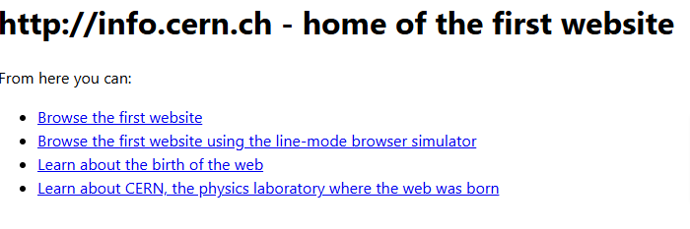
http://info.cern.ch

Slide 3
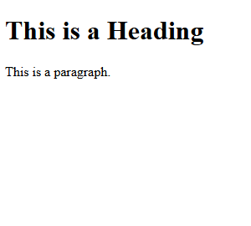
<!DOCTYPE html> <html> <head> <title>Page Title</title> </head> <body> <h1>This is a Heading</h1> <p>This is a paragraph.</p> </body> </html>
Try it Yourself »

Slide 4
What is HTML?
HTML stands for Hyper Text Markup Language
HTML is the standard markup language for creating Web pages
HTML describes the structure of a Web page
HTML consists of a series of elements
HTML elements tell the browser how to display the content
HTML elements label pieces of content such as "this is a heading", "this is a paragraph", "this is a link", etc

Slide 5
HTML Documents
All HTML documents must start with a document type declaration: <!DOCTYPE html>.
The HTML document itself begins with <html> and ends with </html>.
The visible part of the HTML document is between <body> and </body>.
Example
<!DOCTYPE html> <html> <body> <h1>My First Heading</h1> <p>My first paragraph.</p> </body> </html>

Slide 6
The <!DOCTYPE> Declaration
The <!DOCTYPE> declaration represents the document type, and helps browsers to display web pages correctly.
It must only appear once, at the top of the page (before any HTML tags).
The <!DOCTYPE> declaration is not case sensitive.
The <!DOCTYPE> declaration for HTML5 is:
<!DOCTYPE html>

Slide 7
HTML Headings
HTML headings are defined with the <h1> to <h6> tags.
<h1> defines the most important heading. <h6> defines the least important heading:
Example
<h1>This is heading 1</h1> <h2>This is heading 2</h2> <h3>This is heading 3</h3>

Slide 8
HTML Paragraphs
HTML paragraphs are defined with the <p> tag:
Example
<p>This is a paragraph.</p> <p>This is another paragraph.</p>

Slide 9
HTML Links
HTML links are defined with the <a> tag:
Example
<a href="https://www.w3schools.com">This is a link</a>

Slide 10
HTML Images
HTML images are defined with the <img> tag.
The source file (src), alternative text (alt), width, and height are provided as attributes:
Example
<img src="w3schools.jpg" alt="W3Schools.com" width="104" height="142">
Empty HTML Elements
HTML elements with no content are called empty elements.
The <br> tag defines a line break, and is an empty element without a closing tag:
Example
<p>This is a <br> paragraph with a line break.</p>

Slide 11
HTML is Not Case Sensitive
HTML tags are not case sensitive: <P> means the same as <p>.
The href Attribute
The <a> tag defines a hyperlink. The href attribute specifies the URL of the page the link goes to:
Example
<a href="https://www.w3schools.com">Visit W3Schools</a>
The src Attribute
The <img> tag is used to embed an image in an HTML page. The src attribute specifies the path to the image to be displayed:
Example
<img src="img_girl.jpg">

Slide 12
There are two ways to specify the URL in the src attribute:
1. Absolute URL - Links to an external image that is hosted on another website. Example: src="https://www.w3schools.com/images/img_girl.jpg".
Notes: External images might be under copyright. If you do not get permission to use it, you may be in violation of copyright laws. In addition, you cannot control external images; it can suddenly be removed or changed.
2. Relative URL - Links to an image that is hosted within the website. Here, the URL does not include the domain name. If the URL begins without a slash, it will be relative to the current page. Example: src="img_girl.jpg". If the URL begins with a slash, it will be relative to the domain. Example: src="/images/img_girl.jpg".
Tip: It is almost always best to use relative URLs. They will not break if you change domain.

Slide 13
The width and height Attributes
The <img> tag should also contain the width and height attributes, which specify the width and height of the image (in pixels):
Example
<img src="img_girl.jpg" width="500" height="600">

Slide 14
The alt Attribute
The required alt attribute for the <img> tag specifies an alternate text for an image, if the image for some reason cannot be displayed. This can be due to a slow connection, or an error in the src attribute, or if the user uses a screen reader.
Example
<img src="img_girl.jpg" alt="Girl with a jacket">

Slide 15
HTML Headings
HTML headings are defined with the <h1> to <h6> tags.
<h1> defines the most important heading. <h6> defines the least important heading.
Example
<h1>Heading 1</h1> <h2>Heading 2</h2> <h3>Heading 3</h3> <h4>Heading 4</h4> <h5>Heading 5</h5> <h6>Heading 6</h6>
Headings Are Important
Search engines use the headings to index the structure and content of your web pages.
Users often skim a page by its headings. It is important to use headings to show the document structure.
<h1> headings should be used for main headings, followed by <h2> headings, then the less important <h3>, and so on.
Note: Use HTML headings for headings only. Don't use headings to make text BIG or bold.

Slide 16
Bigger Headings
Each HTML heading has a default size. However, you can specify the size for any heading with the style attribute, using the CSS font-size property:
Example
<h1 style="font-size:60px;">Heading 1</h1>
HTML Paragraphs
The HTML <p> element defines a paragraph.
A paragraph always starts on a new line, and browsers automatically add some white space (a margin) before and after a paragraph.
Example
<p>This is a paragraph.</p> <p>This is another paragraph.</p>

Slide 17
HTML Display
You cannot be sure how HTML will be displayed.
Large or small screens, and resized windows will create different results.
With HTML, you cannot change the display by adding extra spaces or extra lines in your HTML code.
The browser will automatically remove any extra spaces and lines when the page is displayed:
Example
<p> This paragraph contains a lot of lines in the source code, but the browser ignores it. </p> <p> This paragraph contains a lot of spaces in the source code, but the browser ignores it. </p>

Slide 18
HTML Horizontal Rules
The <hr> tag defines a thematic break in an HTML page, and is most often displayed as a horizontal rule.
The <hr> element is used to separate content (or define a change) in an HTML page:
Example
<h1>This is heading 1</h1> <p>This is some text.</p> <hr> <h2>This is heading 2</h2> <p>This is some other text.</p> <hr>
HTML Line Breaks
The HTML <br> element defines a line break.
Use <br> if you want a line break (a new line) without starting a new paragraph:
Example
<p>This is<br>a paragraph<br>with line breaks.</p>

Slide 19
Solution - The HTML <pre> Element
The HTML <pre> element defines preformatted text.
The text inside a <pre> element is displayed in a fixed-width font (usually Courier), and it preserves both spaces and line breaks:
Example
<pre> My Bonnie lies over the ocean. My Bonnie lies over the sea. My Bonnie lies over the ocean. Oh, bring back my Bonnie to me. </pre>
The Poem Problem
This poem will display on a single line:
Example
<p> My Bonnie lies over the ocean. My Bonnie lies over the sea. My Bonnie lies over the ocean. Oh, bring back my Bonnie to me. </p>

Slide 20
Tag | Description
<p> | Defines a paragraph
<hr> | Defines a thematic change in the content
<br> | Inserts a single line break
<pre> | Defines pre-formatted text

Slide 21
The HTML style attribute is used to add styles to an element, such as color, font, size, and more.
Example
I am Red
I am Blue
I am Big

Slide 22
The HTML Style Attribute
Setting the style of an HTML element, can be done with the style attribute.
The HTML style attribute has the following syntax:
<tagname style="property:value;">
The property is a CSS property. The value is a CSS value.

Slide 23
Background Color
The CSS background-color property defines the background color for an HTML element.
Example
Set the background color for a page to powderblue:
<body style="background-color:powderblue;"> <h1>This is a heading</h1> <p>This is a paragraph.</p> </body>

Slide 24
Example
Set background color for two different elements:
<body> <h1 style="background-color:powderblue;">This is a heading</h1> <p style="background-color:tomato;">This is a paragraph.</p> </body>

Slide 25
Text Color
The CSS color property defines the text color for an HTML element:
Example
<h1 style="color:blue;">This is a heading</h1> <p style="color:red;">This is a paragraph.</p>

Slide 26
Fonts
The CSS font-family property defines the font to be used for an HTML element:
Example
<h1 style="font-family:verdana;">This is a heading</h1> <p style="font-family:courier;">This is a paragraph.</p>

Slide 27
Text Size
The CSS font-size property defines the text size for an HTML element:
Example
<h1 style="font-size:300%;">This is a heading</h1> <p style="font-size:160%;">This is a paragraph.</p>

Slide 28
Text Alignment
The CSS text-align property defines the horizontal text alignment for an HTML element:
Example
<h1 style="text-align:center;">Centered Heading</h1> <p style="text-align:center;">Centered paragraph.</p>

Slide 29
Chapter Summary
Use the style attribute for styling HTML elements
Use background-color for background color
Use color for text colors
Use font-family for text fonts
Use font-size for text sizes
Use text-align for text alignment

Slide 30
HTML contains several elements for defining text with a special meaning.
HTML Formatting Elements
Formatting elements were designed to display special types of text:
<b> - Bold text
<strong> - Important text
<i> - Italic text
<em> - Emphasized text
<mark> - Marked text
<small> - Smaller text
<del> - Deleted text
<ins> - Inserted text
<sub> - Subscript text
<sup> - Superscript text
Example
This text is bold
This text is italic
This is _{subscript} and ^{superscript}

Slide 31
HTML <i> and <em> Elements
The HTML <i> element defines a part of text in an alternate voice or mood. The content inside is typically displayed in italic.
Tip: The <i> tag is often used to indicate a technical term, a phrase from another language, a thought, a ship name, etc.
Example
<i>This text is italic</i>
Try it Yourself »
The HTML <em> element defines emphasized text. The content inside is typically displayed in italic.
Tip: A screen reader will pronounce the words in <em> with an emphasis, using verbal stress.
Example
<em>This text is emphasized</em>
HTML <b> and <strong> Elements
The HTML <b> element defines bold text, without any extra importance.
Example
<b>This text is bold</b>
Try it Yourself »
The HTML <strong> element defines text with strong importance. The content inside is typically displayed in bold.
Example
<strong>This text is important!</strong>

Slide 32
HTML <small> Element
The HTML <small> element defines smaller text:
Example
<small>This is some smaller text.</small>
HTML <mark> Element
The HTML <mark> element defines text that should be marked or highlighted:
Example
<p>Do not forget to buy <mark>milk</mark> today.</p>

Slide 33
HTML <ins> Element
The HTML <ins> element defines a text that has been inserted into a document. Browsers will usually underline inserted text:
Example
<p>My favorite color is <del>blue</del> <ins>red</ins>.</p>
HTML <del> Element
The HTML <del> element defines text that has been deleted from a document. Browsers will usually strike a line through deleted text:
Example
<p>My favorite color is <del>blue</del> red.</p>
Try it Yourself »

Slide 34
HTML <sub> Element
The HTML <sub> element defines subscript text. Subscript text appears half a character below the normal line, and is sometimes rendered in a smaller font. Subscript text can be used for chemical formulas, like H₂O:
Example
<p>This is <sub>subscripted</sub> text.</p>
Tag | Description
<b> | Defines bold text
<em> | Defines emphasized text
<i> | Defines a part of text in an alternate voice or mood
<small> | Defines smaller text
<strong> | Defines important text
<sub> | Defines subscripted text
<sup> | Defines superscripted text
<ins> | Defines inserted text
<del> | Defines deleted text
<mark> | Defines marked/highlighted text
HTML <sup> Element
The HTML <sup> element defines superscript text. Superscript text appears half a character above the normal line, and is sometimes rendered in a smaller font. Superscript text can be used for footnotes, like WWW^{[1]}:
Example
<p>This is <sup>superscripted</sup> text.</p>

Slide 35
Example
Here is a quote from WWF's website:
For 60 years, WWF has worked to help people and nature thrive. As the world's leading conservation organization, WWF works in nearly 100 countries. At every level, we collaborate with people around the world to develop and deliver innovative solutions that protect communities, wildlife, and the places in which they live.
In this chapter we will go through the <blockquote>,<q>, <abbr>, <address>, <cite>, and <bdo> HTML elements.
https://www.w3schools.com/html/html_quotation_elements.asp

Slide 36
HTML <blockquote> for Quotations
The HTML <blockquote> element defines a section that is quoted from another source.
Browsers usually indent <blockquote> elements.
Example
<p>Here is a quote from WWF's website:</p> <blockquote cite="http://www.worldwildlife.org/who/index.html"> For 60 years, WWF has worked to help people and nature thrive. As the world's leading conservation organization, WWF works in nearly 100 countries. At every level, we collaborate with people around the world to develop and deliver innovative solutions that protect communities, wildlife, and the places in which they live. </blockquote>

Slide 37
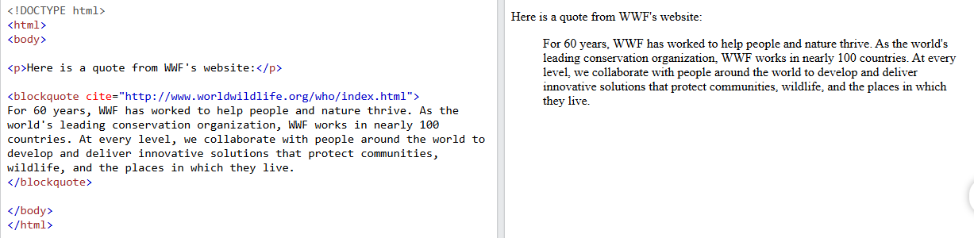

Slide 38
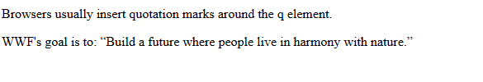
HTML <q> for Short Quotations
The HTML <q> tag defines a short quotation.
Browsers normally insert quotation marks around the quotation.
Example
<p>WWF's goal is to: <q>Build a future where people live in harmony with nature.</q></p>
https://www.w3schools.com/html/html_quotation_elements.asp

Slide 39
HTML <abbr> for Abbreviations
The HTML <abbr> tag defines an abbreviation or an acronym, like "HTML", "CSS", "Mr.", "Dr.", "ASAP", "ATM".
Marking abbreviations can give useful information to browsers, translation systems and search-engines.
Tip: Use the global title attribute to show the description for the abbreviation/acronym when you mouse over the element.
Example
<p>The <abbr title="World Health Organization">WHO</abbr> was founded in 1948.</p>

Slide 40
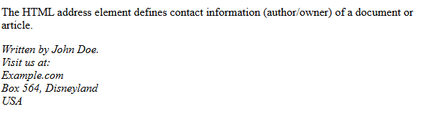
HTML <address> for Contact Information
The HTML <address> tag defines the contact information for the author/owner of a document or an article.
The contact information can be an email address, URL, physical address, phone number, social media handle, etc.
The text in the <address> element usually renders in italic, and browsers will always add a line break before and after the <address> element.
Example
<address> Written by John Doe.<br> Visit us at:<br> Example.com<br> Box 564, Disneyland<br> USA </address>

Slide 41
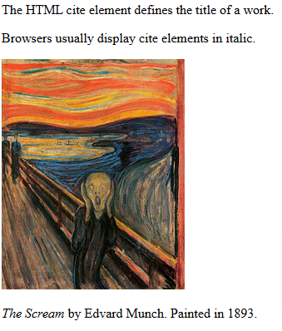
HTML <cite> for Work Title
The HTML <cite> tag defines the title of a creative work (e.g. a book, a poem, a song, a movie, a painting, a sculpture, etc.).
Note: A person's name is not the title of a work.
The text in the <cite> element usually renders in italic.
Example
<p><cite>The Scream</cite> by Edvard Munch. Painted in 1893.</p>

Slide 42
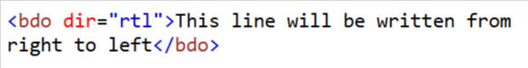
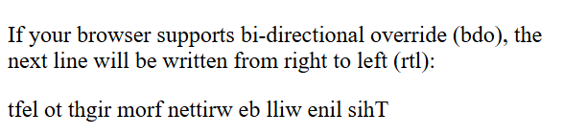
HTML <bdo> for Bi-Directional Override
BDO stands for Bi-Directional Override.
The HTML <bdo> tag is used to override the current text direction:
Example
<bdo dir="rtl">This text will be written from right to left</bdo>
Tag | Description
<abbr> | Defines an abbreviation or acronym
<address> | Defines contact information for the author/owner of a document
<bdo> | Defines the text direction
<blockquote> | Defines a section that is quoted from another source
<cite> | Defines the title of a work
<q> | Defines a short inline quotation

Slide 43
HTML Comment Tag
You can add comments to your HTML source by using the following syntax:
<!-- Write your comments here -->
Add Comments
With comments you can place notifications and reminders in your HTML code:
Example
<!-- This is a comment --> <p>This is a paragraph.</p> <!-- Remember to add more information here -->

Slide 44
Hide Content
Comments can be used to hide content.
This can be helpful if you hide content temporarily:
Example
<p>This is a paragraph.</p> <!-- <p>This is another paragraph </p> --> <p>This is a paragraph too.</p>

Slide 45
You can also hide more than one line. Everything between the <!-- and the --> will be hidden from the display.
Example
Hide a section of HTML code:
<p>This is a paragraph.</p> <!-- <p>Look at this cool image:</p> <img border="0" src="pic_trulli.jpg" alt="Trulli"> --> <p>This is a paragraph too.</p>
Hide Inline Content
Comments can be used to hide parts in the middle of the HTML code.
Example
Hide a part of a paragraph:
<p>This <!-- great text --> is a paragraph.</p>

Slide 46
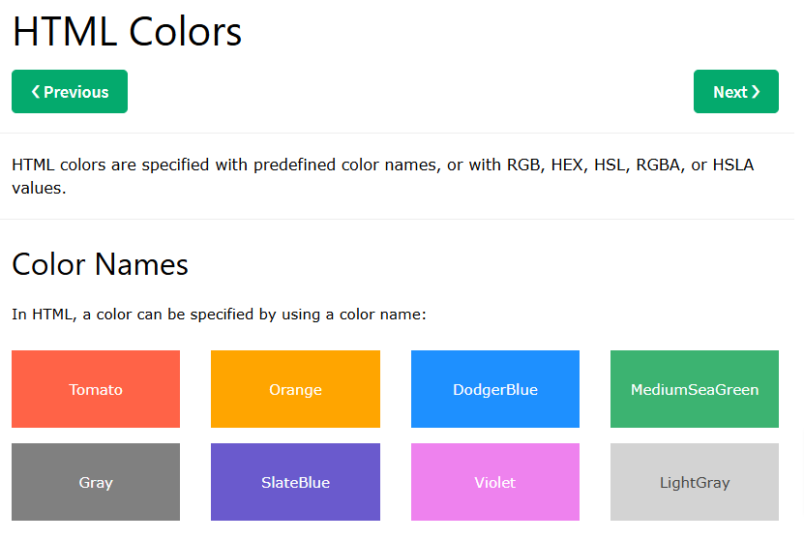
HTML colors are specified with predefined color names, or with RGB, HEX, HSL, RGBA, or HSLA values.

Slide 47
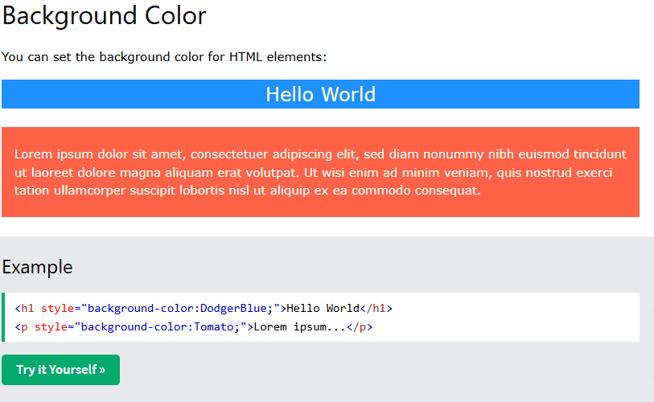

Slide 48
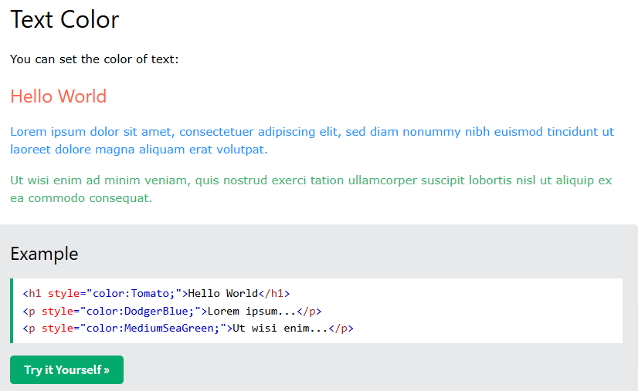

Slide 49
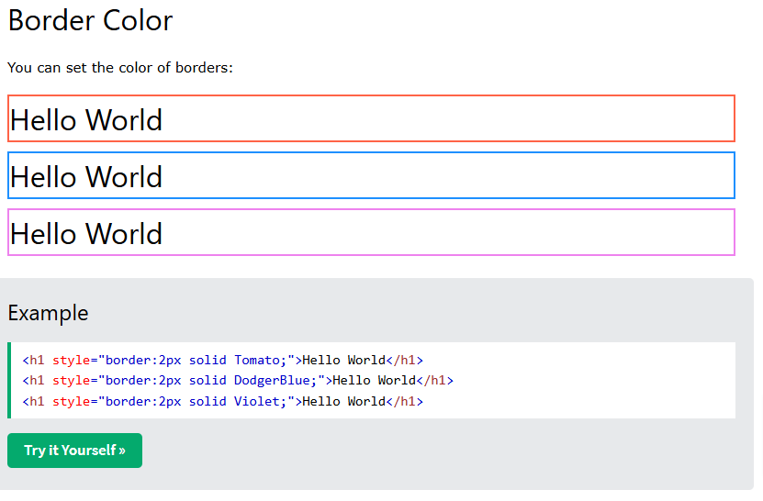
Solid حتما باید وارد کنید والا نشون نمیده.

Slide 50
<!DOCTYPE html>
<html>
<head>
<style>
p{
border-width: 300px;
border-color: blueviolet;
border: 5px;
border-style: solid;
}
</style>
</head>
<body>
<p>The <abbr title="World Health Organization">WHO</abbr> was founded in 1948.</p>
<p>Marking up abbreviations can give useful information to browsers, translation systems and search-engines.</p>
</body>
</html>
<!DOCTYPE html>
<html>
<head>
</head>
<body>
<p style=“border-width:300px; border-color: blueviolet; border: 5px; border-style: solid;
”>The <abbr title="World Health Organization">WHO</abbr> was founded in 1948.</p>
<p>Marking up abbreviations can give useful information to browsers, translation systems and search-engines.</p>
</body>
</html>

Slide 51
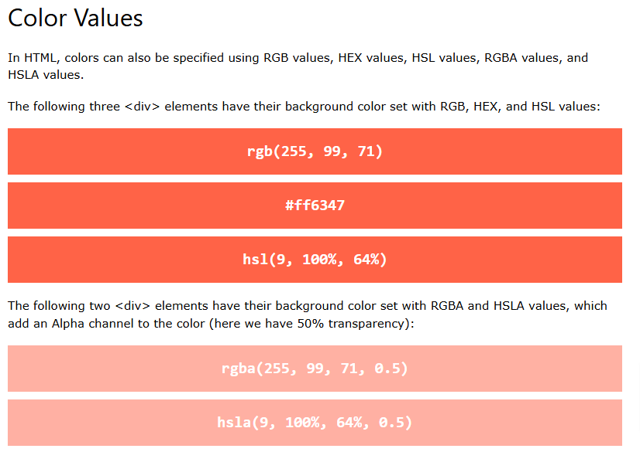

Slide 52
Example
<h1 style="background-color:rgb(255, 99, 71);">...</h1> <h1 style="background-color:#ff6347;">...</h1> <h1 style="background-color:hsl(9, 100%, 64%);">...</h1> <h1 style="background-color:rgba(255, 99, 71, 0.5);">...</h1> <h1 style="background-color:hsla(9, 100%, 64%, 0.5);">...</h1>

Slide 53
RGB Color Values
In HTML, a color can be specified as an RGB value, using this formula:
rgb(red, green, blue)
Each parameter (red, green, and blue) defines the intensity of the color with a value between 0 and 255.
This means that there are 256 x 256 x 256 = 16777216 possible colors!
For example, rgb(255, 0, 0) is displayed as red, because red is set to its highest value (255), and the other two (green and blue) are set to 0.
Another example, rgb(0, 255, 0) is displayed as green, because green is set to its highest value (255), and the other two (red and blue) are set to 0.
To display black, set all color parameters to 0, like this: rgb(0, 0, 0).
To display white, set all color parameters to 255, like this: rgb(255, 255, 255).
Experiment by mixing the RGB values below:

Slide 54
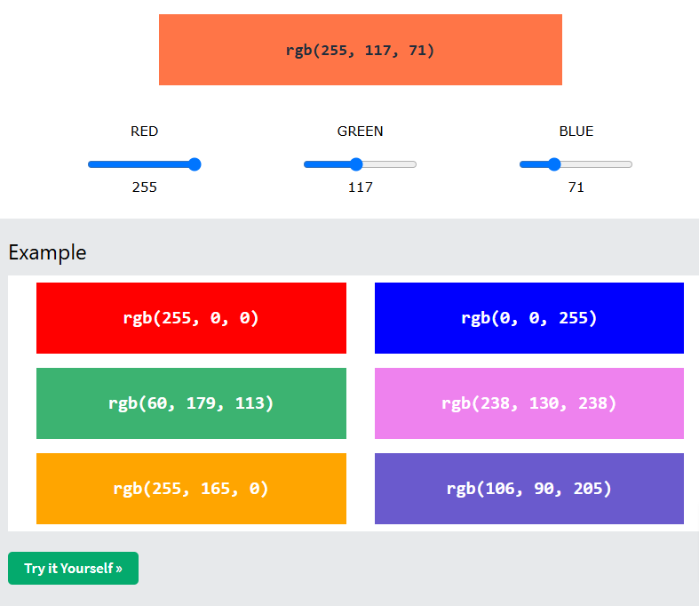

Slide 55
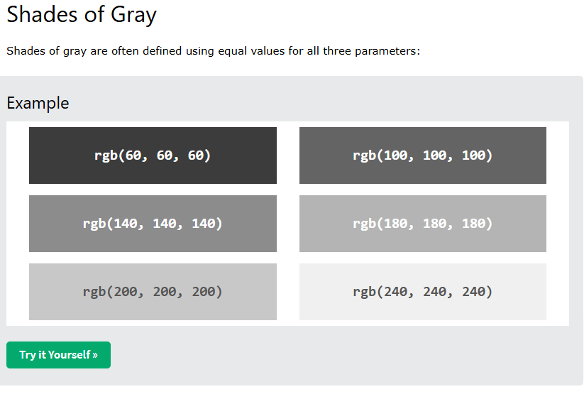

Slide 56
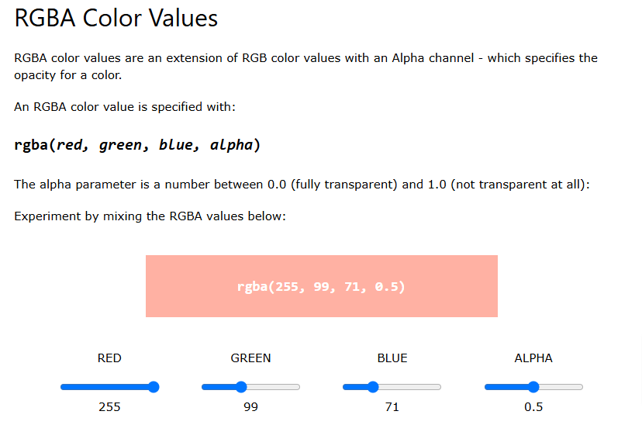

Slide 57
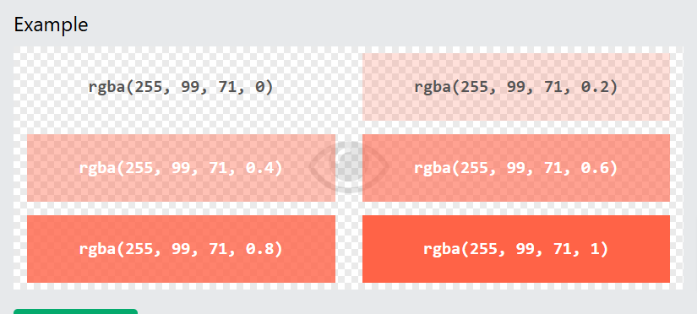

Slide 58
HEX Color Values
In HTML, a color can be specified using a hexadecimal value in the form:
#rrggbb
Where rr (red), gg (green) and bb (blue) are hexadecimal values between 00 and ff (same as decimal 0-255).
For example, #ff0000 is displayed as red, because red is set to its highest value (ff), and the other two (green and blue) are set to 00.
Another example, #00ff00 is displayed as green, because green is set to its highest value (ff), and the other two (red and blue) are set to 00.
To display black, set all color parameters to 00, like this: #000000.
To display white, set all color parameters to ff, like this: #ffffff.
Experiment by mixing the HEX values below:

Slide 59
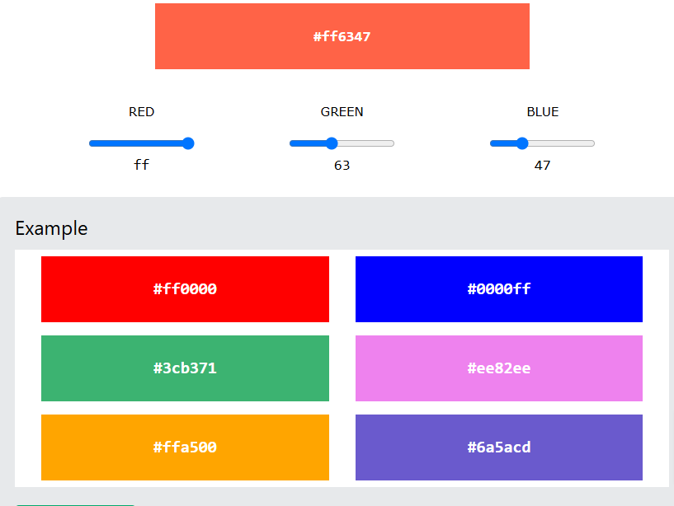

Slide 60
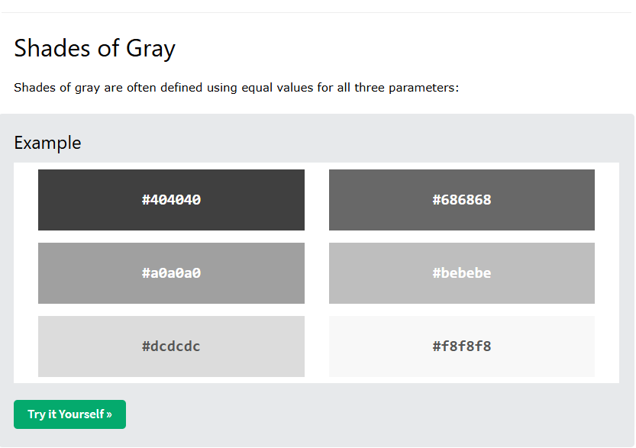

Slide 61
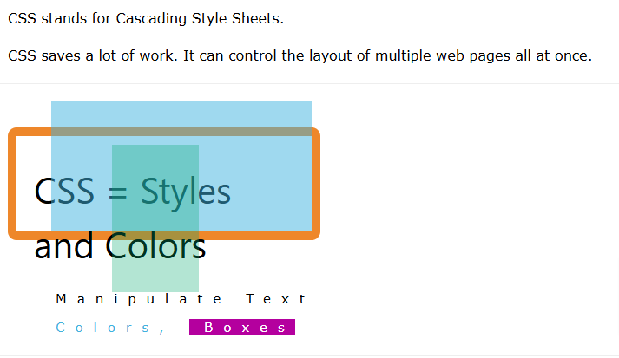

Slide 62
What is CSS?
Cascading Style Sheets (CSS) is used to format the layout of a webpage.
With CSS, you can control the color, font, the size of text, the spacing between elements, how elements are positioned and laid out, what background images or background colors are to be used, different displays for different devices and screen sizes, and much more!
Tip: The word cascading means that a style applied to a parent element will also apply to all children elements within the parent. So, if you set the color of the body text to "blue", all headings, paragraphs, and other text elements within the body will also get the same color (unless you specify something else)!

Slide 63
Using CSS
CSS can be added to HTML documents in 3 ways:
Inline - by using the style attribute inside HTML elements
Internal - by using a <style> element in the <head> section
External - by using a <link> element to link to an external CSS file
The most common way to add CSS, is to keep the styles in external CSS files. However, in this tutorial we will use inline and internal styles, because this is easier to demonstrate, and easier for you to try it yourself.

Slide 64
Inline CSS
An inline CSS is used to apply a unique style to a single HTML element.
An inline CSS uses the style attribute of an HTML element.
The following example sets the text color of the <h1> element to blue, and the text color of the <p> element to red:
Example
<h1 style="color:blue;">A Blue Heading</h1> <p style="color:red;">A red paragraph.</p>

Slide 65
Internal CSS
An internal CSS is used to define a style for a single HTML page.
An internal CSS is defined in the <head> section of an HTML page, within a <style> element.
The following example sets the text color of ALL the <h1> elements (on that page) to blue, and the text color of ALL the <p> elements to red. In addition, the page will be displayed with a "powderblue" background color:
Example
<!DOCTYPE html> <html> <head> <style> body {background-color: powderblue;} h1 {color: blue;} p {color: red;} </style> </head> <body> <h1>This is a heading</h1> <p>This is a paragraph.</p> </body> </html>
Try it Yourself »

Slide 66
External CSS
An external style sheet is used to define the style for many HTML pages.
To use an external style sheet, add a link to it in the <head> section of each HTML page:
Example
<!DOCTYPE html> <html> <head> <link rel="stylesheet" href="styles.css"> </head> <body> <h1>This is a heading</h1> <p>This is a paragraph.</p> </body> </html>

Slide 67
The external style sheet can be written in any text editor. The file must not contain any HTML code, and must be saved with a .css extension.
Here is what the "styles.css" file looks like:
"styles.css":
body { background-color: powderblue; } h1 { color: blue; } p { color: red; }

Slide 68
Example
Use of CSS color, font-family and font-size properties:
<!DOCTYPE html> <html> <head> <style> h1 { color: blue; font-family: verdana; font-size: 300%; } p { color: red; font-family: courier; font-size: 160%; } </style> </head> <body> <h1>This is a heading</h1> <p>This is a paragraph.</p> </body> </html>
CSS Colors, Fonts and Sizes
Here, we will demonstrate some commonly used CSS properties. You will learn more about them later.
The CSS color property defines the text color to be used.
The CSS font-family property defines the font to be used.
The CSS font-size property defines the text size to be used.

Slide 69
CSS Border
The CSS border property defines a border around an HTML element.
Tip: You can define a border for nearly all HTML elements.
Example
Use of CSS border property:
p { border: 2px solid powderblue; }

Slide 70
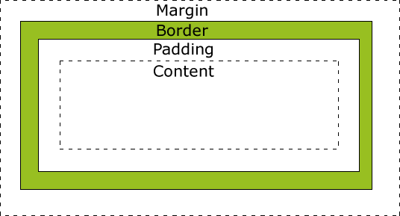
CSS Padding
The CSS padding property defines a padding (space) between the text and the border.
Example
Use of CSS border and padding properties:
p { border: 2px solid powderblue; padding: 30px; }

Slide 71
CSS Margin
The CSS margin property defines a margin (space) outside the border.
Example
Use of CSS border and margin properties:
p { border: 2px solid powderblue; margin: 50px; }

Slide 72
Link to External CSS
External style sheets can be referenced with a full URL or with a path relative to the current web page.
Example
This example uses a full URL to link to a style sheet:
<link rel="stylesheet" href="https://www.w3schools.com/html/styles.css">

Slide 73
Example
This example links to a style sheet located in the html folder on the current web site:
<link rel="stylesheet" href="/html/styles.css">
Try it Yourself »
Example
This example links to a style sheet located in the same folder as the current page:
<link rel="stylesheet" href="styles.css">

Slide 74
Chapter Summary
Use the HTML style attribute for inline styling
Use the HTML <style> element to define internal CSS
Use the HTML <link> element to refer to an external CSS file
Use the HTML <head> element to store <style> and <link> elements
Use the CSS color property for text colors
Use the CSS font-family property for text fonts
Use the CSS font-size property for text sizes
Use the CSS border property for borders
Use the CSS padding property for space inside the border
Use the CSS margin property for space outside the border

Slide 75
Links are found in nearly all web pages. Links allow users to click their way from page to page.
HTML Links - Hyperlinks
HTML links are hyperlinks.
You can click on a link and jump to another document.
When you move the mouse over a link, the mouse arrow will turn into a little hand.
Note: A link does not have to be text. A link can be an image or any other HTML element!
HTML Links - Syntax
The HTML <a> tag defines a hyperlink. It has the following syntax:
<a href="url">link text</a>
The most important attribute of the <a> element is the href attribute, which indicates the link's destination.
The link text is the part that will be visible to the reader.
Clicking on the link text, will send the reader to the specified URL address.

Slide 76
Clicking on the link text, will send the reader to the specified URL address.
Example
This example shows how to create a link to W3Schools.com:
<a href="https://www.w3schools.com/">Visit W3Schools.com!</a>
Try it Yourself »
By default, links will appear as follows in all browsers:
An unvisited link is underlined and blue
A visited link is underlined and purple
An active link is underlined and red

Slide 77
HTML Links - The target Attribute
By default, the linked page will be displayed in the current browser window. To change this, you must specify another target for the link.
The target attribute specifies where to open the linked document.
The target attribute can have one of the following values:
_self - Default. Opens the document in the same window/tab as it was clicked
_blank - Opens the document in a new window or tab
_parent - Opens the document in the parent frame
_top - Opens the document in the full body of the window
Example
Use target="_blank" to open the linked document in a new browser window or tab:
<a href="https://www.w3schools.com/" target="_blank">Visit W3Schools!</a>

Slide 78
Absolute URLs vs. Relative URLs
Both examples above are using an absolute URL (a full web address) in the href attribute.
A local link (a link to a page within the same website) is specified with a relative URL (without the "https://www" part):
Example
<h2>Absolute URLs</h2> <p><a href="https://www.w3.org/">W3C</a></p> <p><a href="https://www.google.com/">Google</a></p> <h2>Relative URLs</h2> <p><a href="html_images.asp">HTML Images</a></p> <p><a href="/css/default.asp">CSS Tutorial</a></p>
HTML Links - Use an Image as a Link
To use an image as a link, just put the <img> tag inside the <a> tag:
Example
<a href="default.asp"> <img src="smiley.gif" alt="HTML tutorial" style="width:42px;height:42px;"> </a>
Try it Yourself »

Slide 79
Link to an Email Address
Use mailto: inside the href attribute to create a link that opens the user's email program (to let them send a new email):
Example
<a href="mailto:someone@example.com">Send email</a>
Button as a Link
To use an HTML button as a link, you have to add some JavaScript code.
JavaScript allows you to specify what happens at certain events, such as a click of a button:
Example
<button onclick="document.location='default.asp'">HTML Tutorial</button>
Try it Yourself »

Slide 80
Link Titles
The title attribute specifies extra information about an element. The information is most often shown as a tooltip text when the mouse moves over the element.
Example
<a href="https://www.w3schools.com/html/" title="Go to W3Schools HTML section">Visit our HTML Tutorial</a>

Slide 81
More on Absolute URLs and Relative URLs
Example
Use a full URL to link to a web page:
<a href="https://www.w3schools.com/html/default.asp">HTML tutorial</a>
Try it Yourself »
Example
Link to a page located in the html folder on the current web site:
<a href="/html/default.asp">HTML tutorial</a>
Try it Yourself »
Example
Link to a page located in the same folder as the current page:
<a href="default.asp">HTML tutorial</a>

Slide 82
Chapter Summary
Use the <a> element to define a link
Use the href attribute to define the link address
Use the target attribute to define where to open the linked document
Use the <img> element (inside <a>) to use an image as a link
Use the mailto: scheme inside the href attribute to create a link that opens the user's email program

Slide 83
<style> a:link { color: green; background-color: transparent; text-decoration: none; } a:visited { color: pink; background-color: transparent; text-decoration: none; } a:hover { color: red; background-color: transparent; text-decoration: underline; } a:active { color: yellow; background-color: transparent; text-decoration: underline; } </style>
HTML Link Colors
By default, a link will appear like this (in all browsers):
An unvisited link is underlined and blue
A visited link is underlined and purple
An active link is underlined and red
You can change the link state colors, by using CSS:
Example
Here, an unvisited link will be green with no underline. A visited link will be pink with no underline. An active link will be yellow and underlined. In addition, when mousing over a link (a:hover) it will become red and underlined:

Slide 84
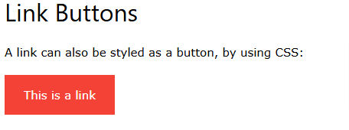
<style> a:link, a:visited { background-color: #f44336; color: white; padding: 15px 25px; text-align: center; text-decoration: none; display: inline-block; } a:hover, a:active { background-color: red; } </style>

Slide 85
Create a Bookmark in HTML
Bookmarks can be useful if a web page is very long.
To create a bookmark - first create the bookmark, then add a link to it.
When the link is clicked, the page will scroll down or up to the location with the bookmark.
Example
First, use the id attribute to create a bookmark:
<h2 id="C4">Chapter 4</h2>
Then, add a link to the bookmark ("Jump to Chapter 4"), from within the same page:
Example
<a href="#C4">Jump to Chapter 4</a>
You can also add a link to a bookmark on another page:
<a href="html_demo.html#C4">Jump to Chapter 4</a>

Slide 86
Chapter Summary
Use the id attribute (id="value") to define bookmarks in a page
Use the href attribute (href="#value") to link to the bookmark

Slide 87
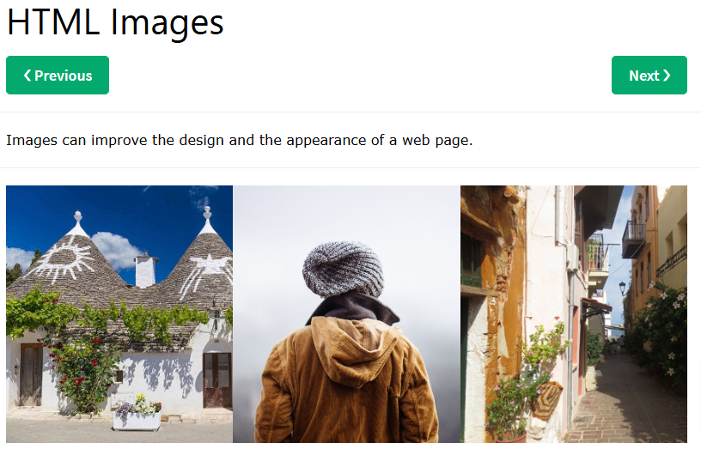

Slide 88
Example
<img src="pic_trulli.jpg" alt="Italian Trulli">
Try it Yourself »
Example
<img src="img_girl.jpg" alt="Girl in a jacket">
Try it Yourself »
Example
<img src="img_chania.jpg" alt="Flowers in Chania">

Slide 89
HTML Images Syntax
The HTML <img> tag is used to embed an image in a web page.
Images are not technically inserted into a web page; images are linked to web pages. The <img> tag creates a holding space for the referenced image.
The <img> tag is empty, it contains attributes only, and does not have a closing tag.
The <img> tag has two required attributes:
src - Specifies the path to the image
alt - Specifies an alternate text for the image
Syntax
<img src="url" alt="alternatetext">

Slide 90
The alt Attribute
The required alt attribute provides an alternate text for an image, if the user for some reason cannot view it (because of slow connection, an error in the src attribute, or if the user uses a screen reader).
The value of the alt attribute should describe the image:
Example
<img src="img_chania.jpg" alt="Flowers in Chania">
Try it Yourself »
If a browser cannot find an image, it will display the value of the alt attribute:
Example
<img src="wrongname.gif" alt="Flowers in Chania">

Slide 91
Image Size - Width and Height
You can use the style attribute to specify the width and height of an image.
Example
<img src="img_girl.jpg" alt="Girl in a jacket" style="width:500px;height:600px;">
Try it Yourself »
Alternatively, you can use the width and height attributes:
Example
<img src="img_girl.jpg" alt="Girl in a jacket" width="500" height="600">
Try it Yourself »
The width and height attributes always define the width and height of the image in pixels.

Slide 92
Width and Height, or Style?
The width, height, and style attributes are all valid in HTML.
However, we suggest using the style attribute. It prevents styles sheets from changing the size of images:
Example
<!DOCTYPE html> <html> <head> <style> img { width: 100%; } </style> </head> <body> <img src="html5.gif" alt="HTML5 Icon" width="128" height="128"> <img src="html5.gif" alt="HTML5 Icon" style="width:128px;height:128px;"> </body> </html>

Slide 93
Images in Another Folder
If you have your images in a sub-folder, you must include the folder name in the src attribute:
Example
<img src="/images/html5.gif" alt="HTML5 Icon" style="width:128px;height:128px;">
Try it Yourself »

Slide 94
Images on Another Server/Website
Some web sites point to an image on another server.
To point to an image on another server, you must specify an absolute (full) URL in the src attribute:
Example
<img src="https://www.w3schools.com/images/w3schools_green.jpg" alt="W3Schools.com">
Try it Yourself »

Slide 95
Animated Images
HTML allows animated GIFs:
Example
<img src="programming.gif" alt="Computer Man" style="width:48px;height:48px;">
Try it Yourself »

Slide 96
Abbreviation | File Format | File Extension
APNG | Animated Portable Network Graphics | .apng
GIF | Graphics Interchange Format | .gif
ICO | Microsoft Icon | .ico, .cur
JPEG | Joint Photographic Expert Group image | .jpg, .jpeg, .jfif, .pjpeg, .pjp
PNG | Portable Network Graphics | .png
SVG | Scalable Vector Graphics | .svg
Image as a Link
To use an image as a link, put the <img> tag inside the <a> tag:
Example
<a href="default.asp"> <img src="smiley.gif" alt="HTML tutorial" style="width:42px;height:42px;"> </a>

Slide 97
Chapter Summary
Use the HTML <img> element to define an image
Use the HTML src attribute to define the URL of the image
Use the HTML alt attribute to define an alternate text for an image, if it cannot be displayed
Use the HTML width and height attributes or the CSS width and height properties to define the size of the image
Use the CSS float property to let the image float to the left or to the right

Slide 98
HTML Image Tags
Tag | Description
<img> | Defines an image
<map> | Defines an image map
<area> | Defines a clickable area inside an image map
<picture> | Defines a container for multiple image resources

Slide 99
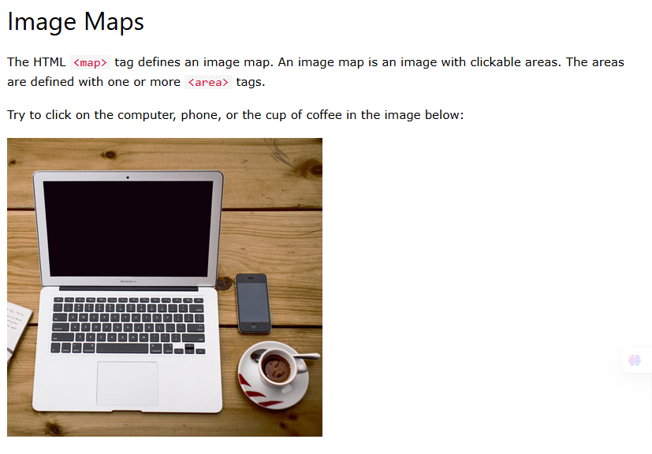

Slide 100
Example
Here is the HTML source code for the image map above:
<img src="workplace.jpg" alt="Workplace" usemap="#workmap"> <map name="workmap"> <area shape="rect" coords="34,44,270,350" alt="Computer" href="computer.htm"> <area shape="rect" coords="290,172,333,250" alt="Phone" href="phone.htm"> <area shape="circle" coords="337,300,44" alt="Coffee" href="coffee.htm"> </map>

Slide 101
How Does it Work?
The idea behind an image map is that you should be able to perform different actions depending on where in the image you click.
To create an image map you need an image, and some HTML code that describes the clickable areas.

Slide 102
The Image
The image is inserted using the <img> tag. The only difference from other images is that you must add a usemap attribute:
<img src="workplace.jpg" alt="Workplace" usemap="#workmap">
The usemap value starts with a hash tag # followed by the name of the image map, and is used to create a relationship between the image and the image map.
Tip: You can use any image as an image map!

Slide 103
Create Image Map
Then, add a <map> element.
The <map> element is used to create an image map, and is linked to the image by using the required name attribute:
<map name="workmap">
The name attribute must have the same value as the <img>'s usemap attribute .

Slide 104
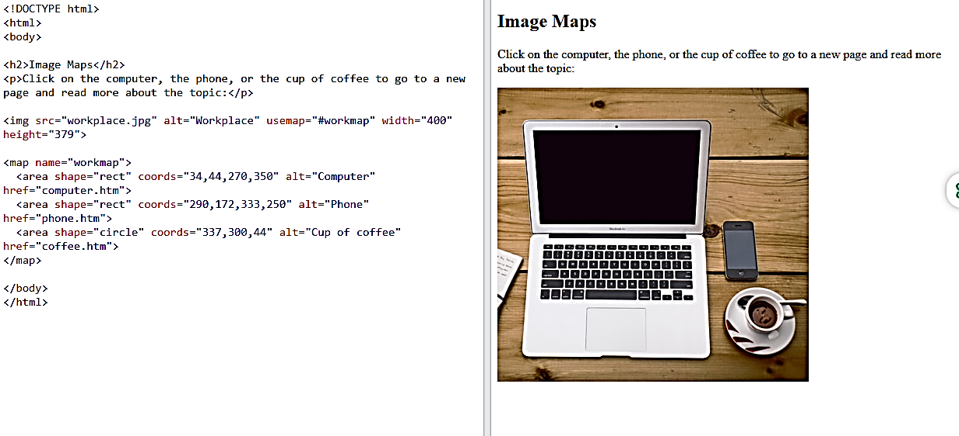
https://www.w3schools.com/html/tryit.asp?filename=tryhtml_images_map2

Slide 105
The Areas
Then, add the clickable areas.
A clickable area is defined using an <area> element.
Shape
You must define the shape of the clickable area, and you can choose one of these values:
rect - defines a rectangular region
circle - defines a circular region
poly - defines a polygonal region
default - defines the entire region
You must also define some coordinates to be able to place the clickable area onto the image.

Slide 106
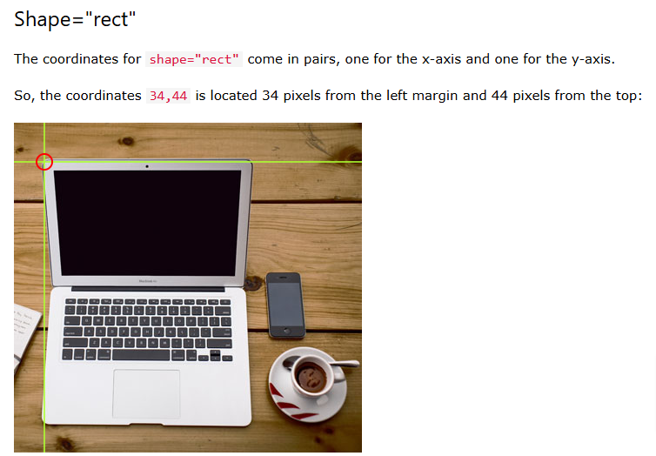
Now we have enough data to create a clickable rectangular area:
Example
<area shape="rect" coords="34, 44, 270, 350" href="computer.htm">

Slide 107
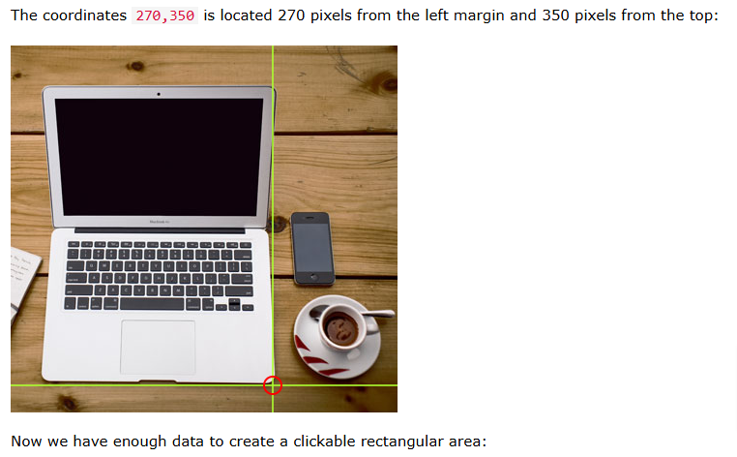
Now we have enough data to create a clickable rectangular area:
Example
<area shape="rect" coords="34, 44, 270, 350" href="computer.htm">

Slide 108
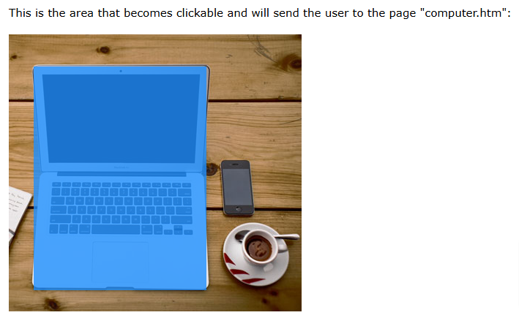

Slide 109
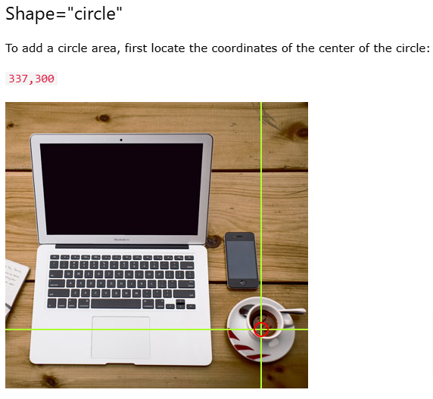
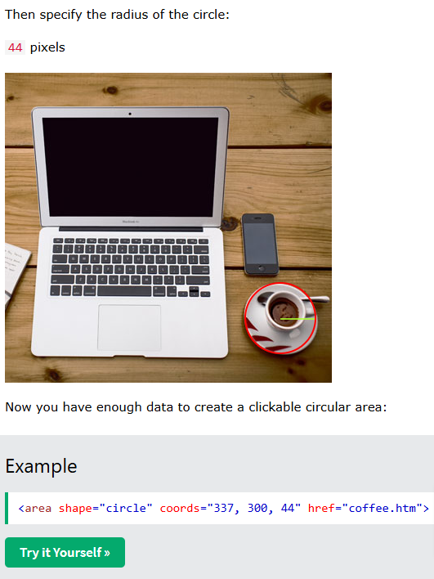
Now you have enough data to create a clickable circular area:
Example
<area shape="circle" coords="337, 300, 44" href="coffee.htm">

Slide 110
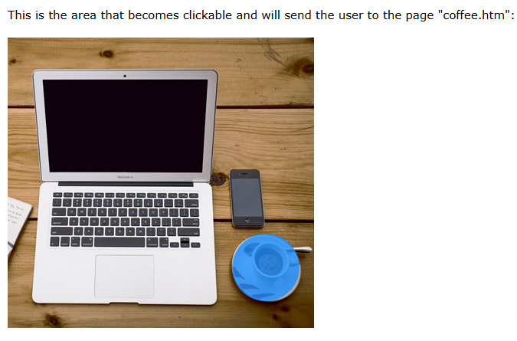

Slide 111
Shape="poly"
The shape="poly" contains several coordinate points, which creates a shape formed with straight lines (a polygon).
This can be used to create any shape.
Like maybe a croissant shape!
How can we make the croissant in the image below become a clickable link?

Slide 112
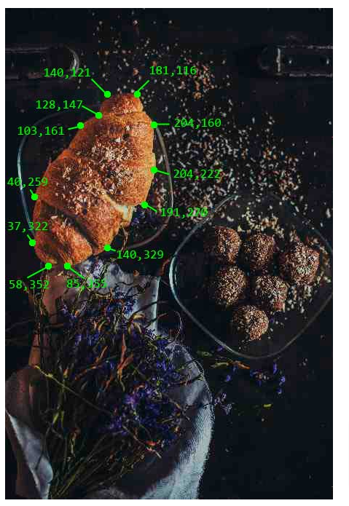
The coordinates come in pairs, one for the x-axis and one for the y-axis:
Example
<area shape="poly" coords="140,121,181,116,204,160,204,222,191,270,140,329,85,355,58,352,37,322,40,259,103,161,128,147" href="croissant.htm">

Slide 113


Slide 114
Image Map and JavaScript
A clickable area can also trigger a JavaScript function.
Add a click event to the <area> element to execute a JavaScript function:
Example
Here, we use the onclick attribute to execute a JavaScript function when the area is clicked:
<map name="workmap"> <area shape="circle" coords="337,300,44" href="coffee.htm" onclick="myFunction()"> </map> <script> function myFunction() { alert("You clicked the coffee cup!"); } </script>

Slide 115
Tag | Description
<img> | Defines an image
<map> | Defines an image map
<area> | Defines a clickable area inside an image map
<picture> | Defines a container for multiple image resources
HTML Image Tags

Slide 116
HTML Background Images
❮ PreviousNext ❯
A background image can be specified for almost any HTML element.
Background Image on a HTML element
To add a background image on an HTML element, use the HTML style attribute and the CSS background-image property:
Example
Add a background image on a HTML element:
<p style="background-image: url('img_girl.jpg');">
Try it Yourself »

Slide 117
A background image can be specified for almost any HTML element.
Background Image on a HTML element
To add a background image on an HTML element, use the HTML style attribute and the CSS background-image property:
Example
Add a background image on a HTML element:
<p style="background-image: url('img_girl.jpg');">
Try it Yourself »
You can also specify the background image in the <style> element, in the <head> section:
Example
Specify the background image in the <style> element:
<style> p { background-image: url('img_girl.jpg'); } </style>

Slide 118
Background Image on a Page
If you want the entire page to have a background image, you must specify the background image on the <body> element:
Example
Add a background image for the entire page:
<style> body { background-image: url('img_girl.jpg'); } </style>

Slide 119

Background Repeat
If the background image is smaller than the element, the image will repeat itself, horizontally and vertically, until it reaches the end of the element:
Example
<style> body { background-image: url('example_img_girl.jpg'); } </style>

Slide 120
To avoid the background image from repeating itself, set the background-repeat property to no-repeat.
Example
<style> body { background-image: url('example_img_girl.jpg'); background-repeat: no-repeat; } </style>

Slide 121
Background Cover
If you want the background image to cover the entire element, you can set the background-size property to cover.
Also, to make sure the entire element is always covered, set the background-attachment property to fixed:
This way, the background image will cover the entire element, with no stretching (the image will keep its original proportions):
Example
<style> body { background-image: url('img_girl.jpg'); background-repeat: no-repeat; background-attachment: fixed; background-size: cover; } </style>

Slide 122
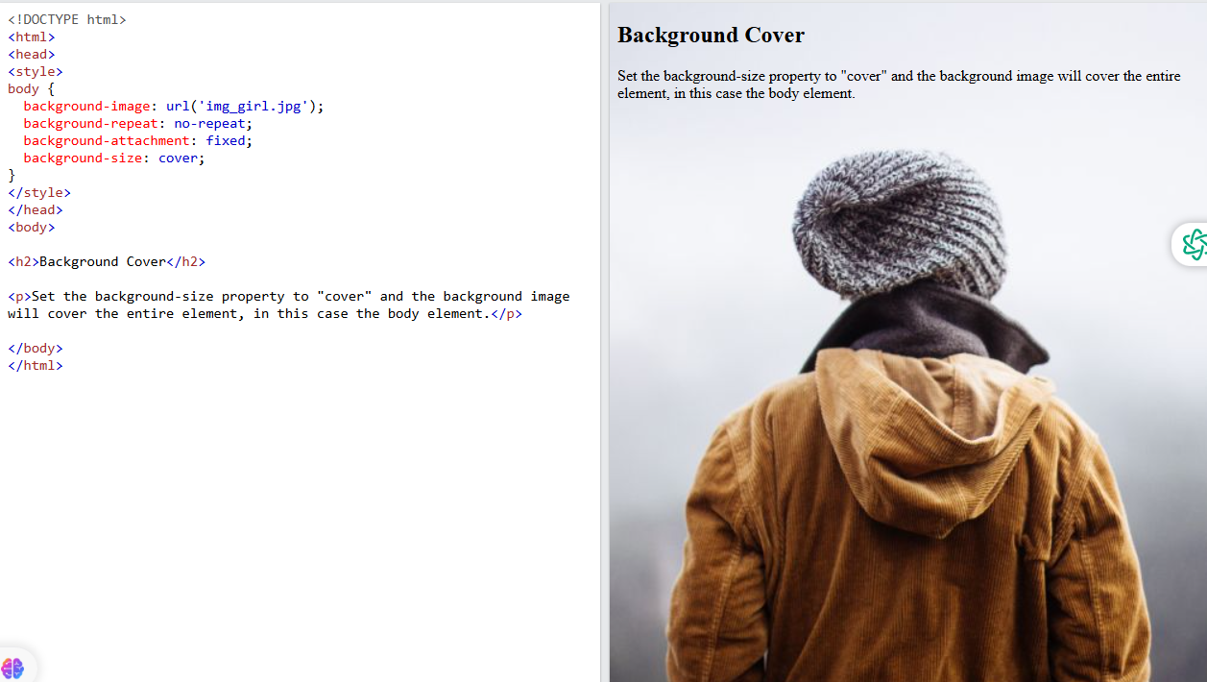

Slide 123

Background Stretch
If you want the background image to stretch to fit the entire element, you can set the background-size property to 100% 100%:
Try resizing the browser window, and you will see that the image will stretch, but always cover the entire element.
Example
<style> body { background-image: url('img_girl.jpg'); background-repeat: no-repeat; background-attachment: fixed; background-size: 100% 100%; } </style>
Background Stretch
If you want the background image to stretch to fit the entire element, you can set the background-size property to 100% 100%:
Try resizing the browser window, and you will see that the image will stretch, but always cover the entire element.
Example
<style> body { background-image: url('img_girl.jpg'); background-repeat: no-repeat; background-attachment: fixed; background-size: 100% 100%; } </style>

Slide 124
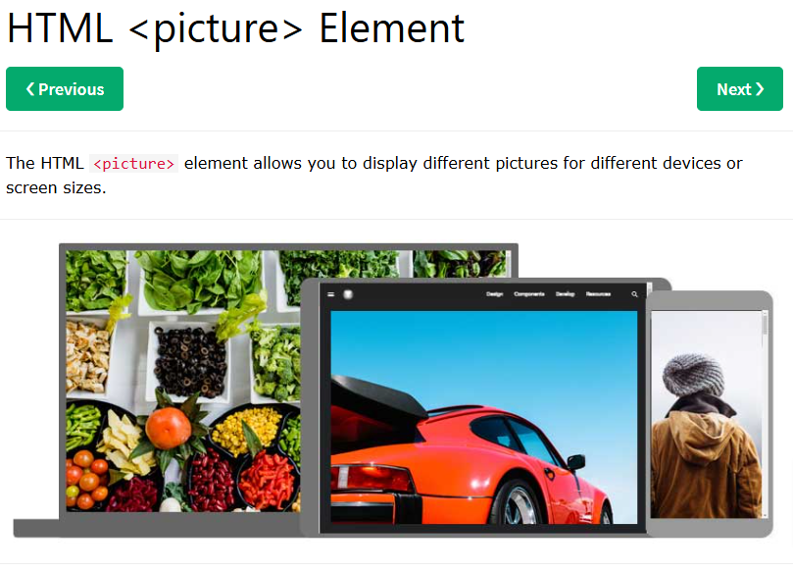

Slide 125
The HTML <picture> Element
The HTML <picture> element gives web developers more flexibility in specifying image resources.
The <picture> element contains one or more <source> elements, each referring to different images through the srcset attribute. This way the browser can choose the image that best fits the current view and/or device.
Each <source> element has a media attribute that defines when the image is the most suitable.
Example
Show different images for different screen sizes:
<picture> <source media="(min-width: 650px)" srcset="img_food.jpg"> <source media="(min-width: 465px)" srcset="img_car.jpg"> <img src="img_girl.jpg"> </picture>
The HTML <picture> Element
The HTML <picture> element gives web developers more flexibility in specifying image resources.
The <picture> element contains one or more <source> elements, each referring to different images through the srcset attribute. This way the browser can choose the image that best fits the current view and/or device.
Each <source> element has a media attribute that defines when the image is the most suitable.
Example
Show different images for different screen sizes:
<picture> <source media="(min-width: 650px)" srcset="img_food.jpg"> <source media="(min-width: 465px)" srcset="img_car.jpg"> <img src="img_girl.jpg"> </picture>

Slide 126
Note: Always specify an <img> element as the last child element of the <picture> element. The <img> element is used by browsers that do not support the <picture> element, or if none of the <source> tags match.

Slide 127
When to use the Picture Element
There are two main purposes for the <picture> element:
1. Bandwidth
If you have a small screen or device, it is not necessary to load a large image file. The browser will use the first <source> element with matching attribute values, and ignore any of the following elements.
2. Format Support
Some browsers or devices may not support all image formats. By using the <picture> element, you can add images of all formats, and the browser will use the first format it recognizes, and ignore any of the following elements.
Example
The browser will use the first image format it recognizes:
<picture> <source srcset="img_avatar.png"> <source srcset="img_girl.jpg"> <img src="img_beatles.gif" alt="Beatles" style="width:auto;"> </picture>

Slide 128
HTML Image Tags
Tag | Description
<img> | Defines an image
<map> | Defines an image map
<area> | Defines a clickable area inside an image map
<picture> | Defines a container for multiple image resources

Slide 129
HTML Favicon
❮ PreviousNext ❯
A favicon is a small image displayed next to the page title in the browser tab.
How To Add a Favicon in HTML
You can use any image you like as your favicon. You can also create your own favicon on sites like https://www.favicon.cc.

Slide 130
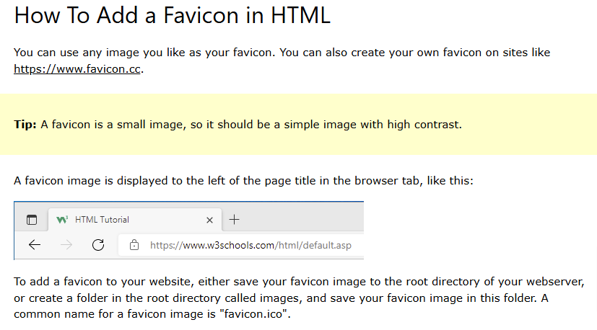

Slide 131
Next, add a <link> element to your "index.html" file, after the <title> element, like this:
Example
<!DOCTYPE html> <html> <head> <title>My Page Title</title> <link rel="icon" type="image/x-icon" href="/images/favicon.ico"> </head> <body> <h1>This is a Heading</h1> <p>This is a paragraph.</p> </body> </html>

Slide 132
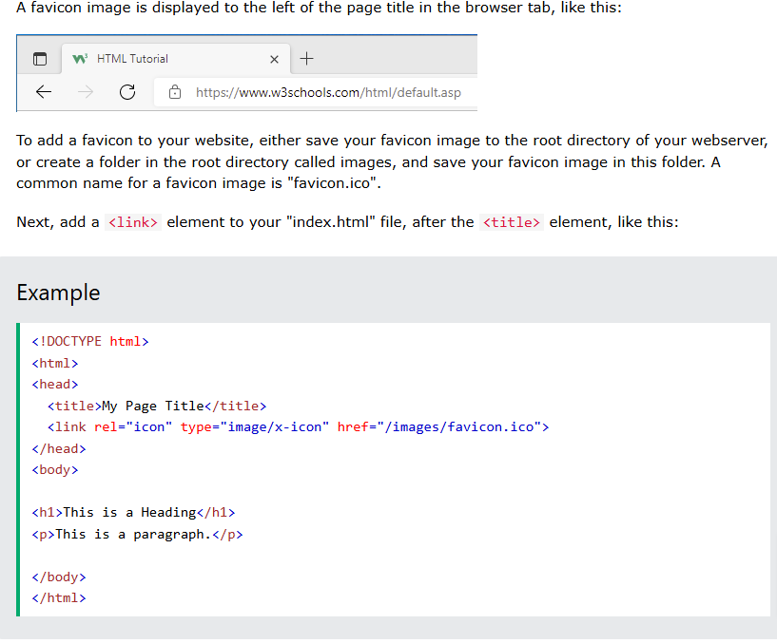

Slide 133
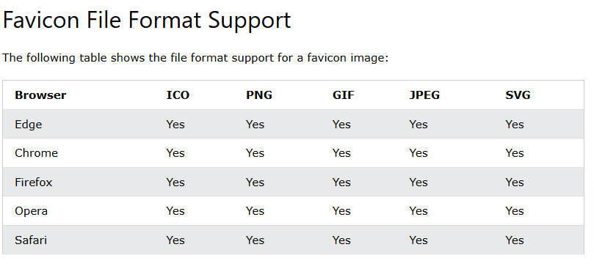

Slide 134
HTML Page Title
❮ PreviousNext ❯
Every web page should have a page title to describe the meaning of the page.
The <title> element adds a title to your page:
Example
<!DOCTYPE html> <html> <head> <title>HTML Tutorial</title> </head> <body> The content of the document...... </body> </html>

Slide 135
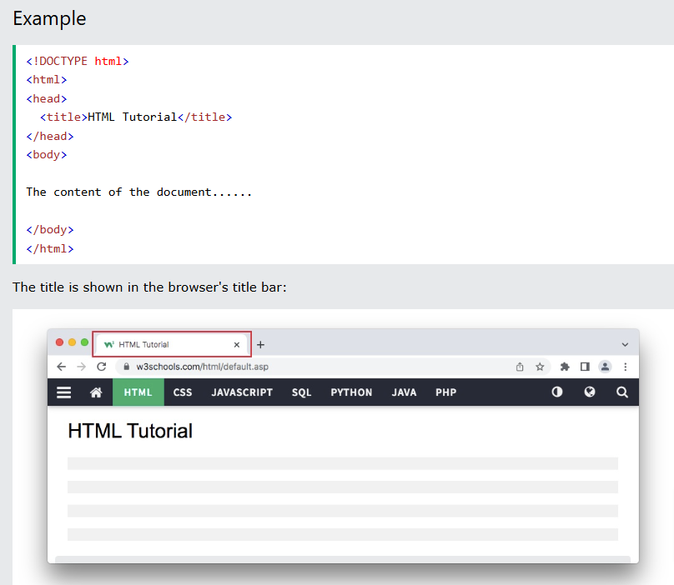

Slide 136
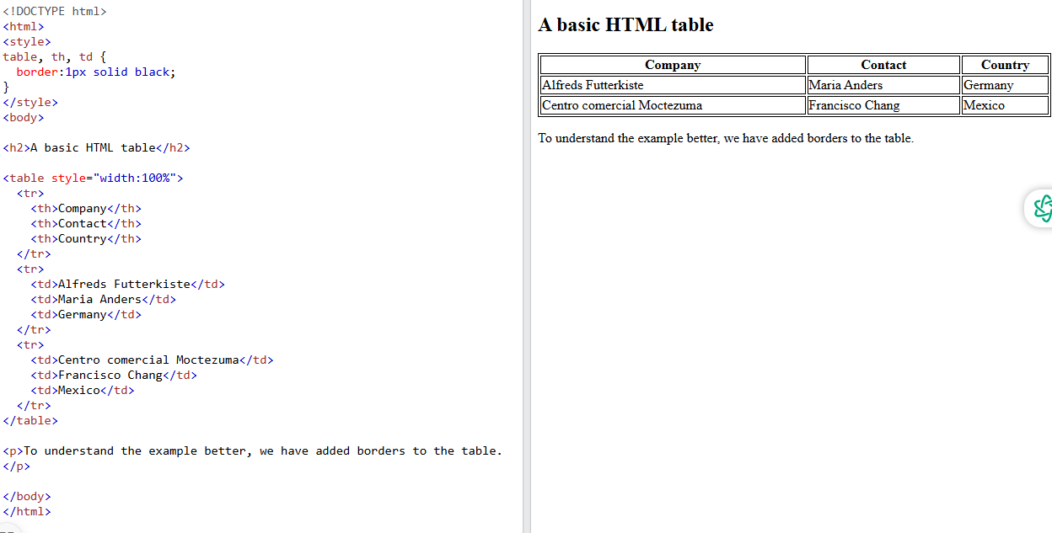

Slide 137
<!DOCTYPE html>
<html>
<style>
table, th, td {
border:1px solid black;
}
</style>
<body>
<h2>A basic HTML table</h2>
<table style="width:100%">
<tr>
<th>Company</th>
<th>Contact</th>
<th>Country</th>
</tr>
<tr>
<td>Alfreds Futterkiste</td>
<td>Maria Anders</td>
<td>Germany</td>
</tr>
<tr>
<td>Centro comercial Moctezuma</td>
<td>Francisco Chang</td>
<td>Mexico</td>
</tr>
</table>
<p>To understand the example better, we have added borders to the table.</p>
</body>
</html>

Slide 138
Table Cells
Each table cell is defined by a <td> and a </td> tag.
td stands for table data.
Everything between <td> and </td> are the content of the table cell.
Example
<table> <tr> <td>Emil</td> <td>Tobias</td> <td>Linus</td> </tr> </table>
Table Cells
Each table cell is defined by a <td> and a </td> tag.
td stands for table data.
Everything between <td> and </td> are the content of the table cell.
Example
<table> <tr> <td>Emil</td> <td>Tobias</td> <td>Linus</td> </tr> </table>

Slide 139
Table Rows
Each table row starts with a <tr> and ends with a </tr> tag.
tr stands for table row.
Example
<table> <tr> <td>Emil</td> <td>Tobias</td> <td>Linus</td> </tr> <tr> <td>16</td> <td>14</td> <td>10</td> </tr> </table>
Try it Yourself »

Slide 140
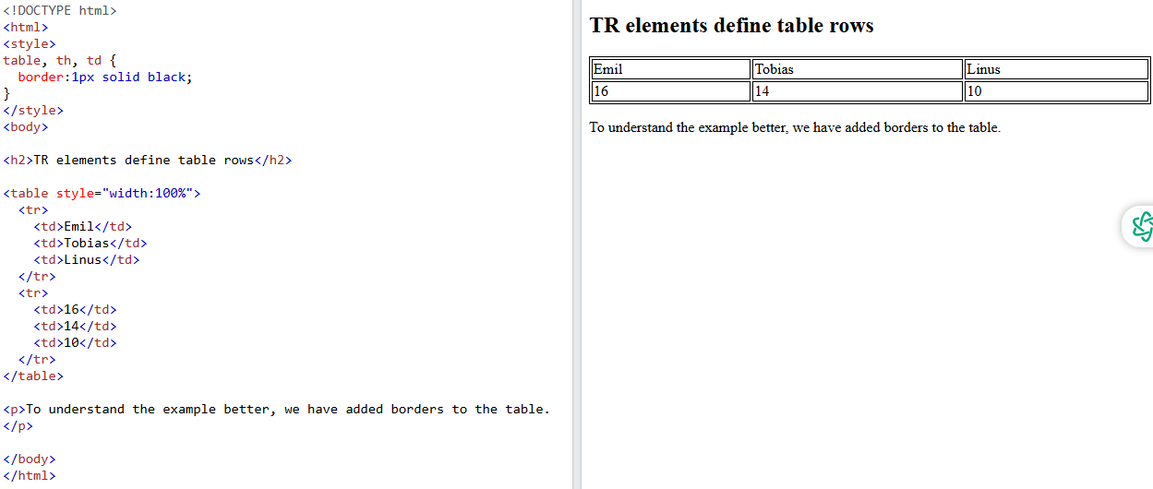

Slide 141
HTML Table Tags
Tag | Description
<table> | Defines a table
<th> | Defines a header cell in a table
<tr> | Defines a row in a table
<td> | Defines a cell in a table
<caption> | Defines a table caption
<colgroup> | Specifies a group of one or more columns in a table for formatting
<col> | Specifies column properties for each column within a <colgroup> element
<thead> | Groups the header content in a table
<tbody> | Groups the body content in a table
<tfoot> | Groups the footer content in a table

Slide 142
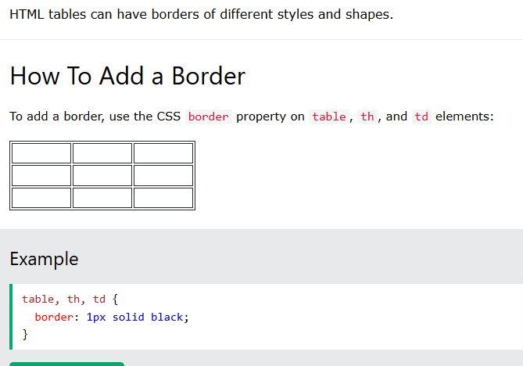
table, th, td { border: 1px solid black; }

Slide 143
Collapsed Table Borders
To avoid having double borders like in the example above, set the CSS border-collapse property to collapse.
This will make the borders collapse into a single border:
Example
table, th, td { border: 1px solid black; border-collapse: collapse; }

Slide 144
Style Table Borders
If you set a background color of each cell, and give the border a white color (the same as the document background), you get the impression of an invisible border:
Example
table, th, td { border: 1px solid white; border-collapse: collapse; } th, td { background-color: #96D4D4; }

Slide 145
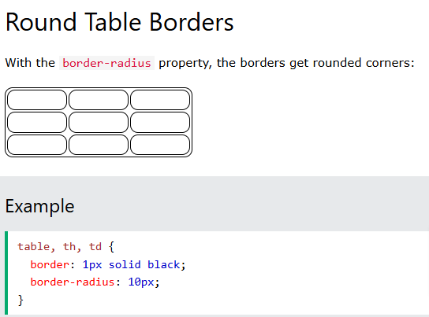

Slide 146
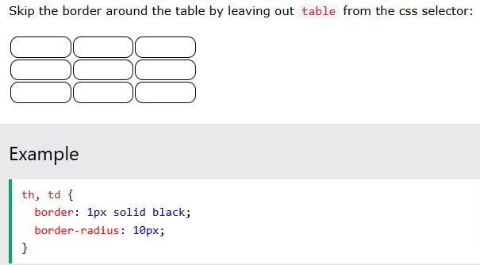

Slide 147
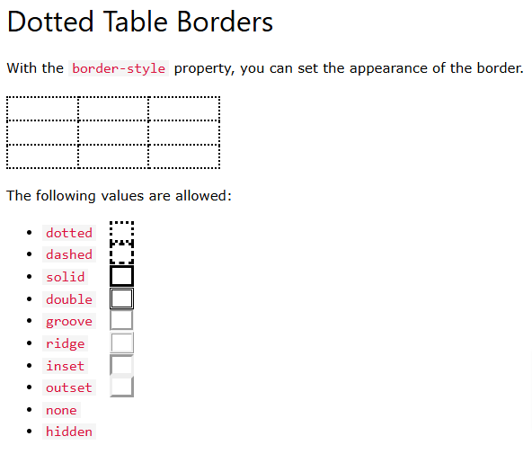
The following values are allowed:
dotted
dashed
solid
double
groove
ridge
inset
outset
none
hidden
Example
th, td { border-style: dotted; }

Slide 148
The following values are allowed:
dotted
dashed
solid
double
groove
ridge
inset
outset
none
hidden
Example
th, td { border-style: dotted; }
The following values are allowed:
dotted
dashed
solid
double
groove
ridge
inset
outset
none
hidden
Example
th, td { border-style: dotted; }

Slide 149
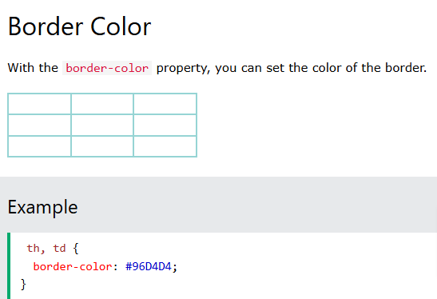
Border Color
With the border-color property, you can set the color of the border.
Example
th, td { border-color: #96D4D4; }

Slide 150
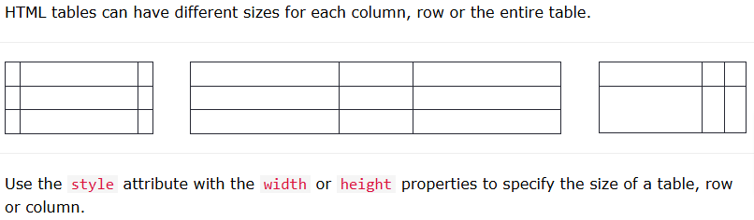

Slide 151
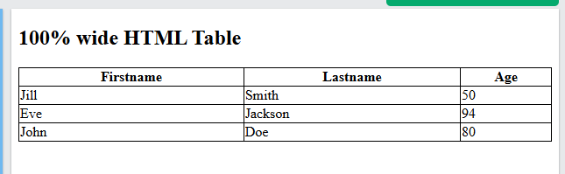
<table style="width:100%"> <tr> <th>Firstname</th> <th>Lastname</th> <th>Age</th> </tr> <tr> <td>Jill</td> <td>Smith</td> <td>50</td> </tr> <tr> <td>Eve</td> <td>Jackson</td> <td>94</td> </tr> </table>

Slide 152
HTML Table Column Width
To set the size of a specific column, add the style attribute on a <th> or <td> element:
Example
Set the width of the first column to 70%:
<table style="width:100%"> <tr> <th style="width:70%">Firstname</th> <th>Lastname</th> <th>Age</th> </tr> <tr> <td>Jill</td> <td>Smith</td> <td>50</td> </tr> <tr> <td>Eve</td> <td>Jackson</td> <td>94</td> </tr> </table>

Slide 153
HTML Table Row Height
To set the height of a specific row, add the style attribute on a table row element:
Example
Set the height of the second row to 200 pixels:
<table style="width:100%"> <tr> <th>Firstname</th> <th>Lastname</th> <th>Age</th> </tr> <tr style="height:200px"> <td>Jill</td> <td>Smith</td> <td>50</td> </tr> <tr> <td>Eve</td> <td>Jackson</td> <td>94</td> </tr> </table>

Slide 154
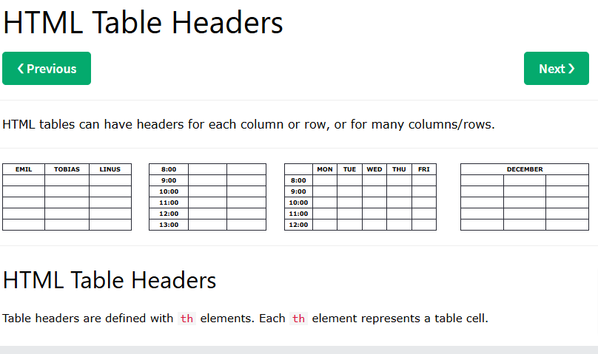

Slide 155
Vertical Table Headers
To use the first column as table headers, define the first cell in each row as a <th> element:
Example
<table> <tr> <th>Firstname</th> <td>Jill</td> <td>Eve</td> </tr> <tr> <th>Lastname</th> <td>Smith</td> <td>Jackson</td> </tr> <tr> <th>Age</th> <td>94</td> <td>50</td> </tr> </table>
Vertical Table Headers
To use the first column as table headers, define the first cell in each row as a <th> element:
Example
<table> <tr> <th>Firstname</th> <td>Jill</td> <td>Eve</td> </tr> <tr> <th>Lastname</th> <td>Smith</td> <td>Jackson</td> </tr> <tr> <th>Age</th> <td>94</td> <td>50</td> </tr> </table>

Slide 156
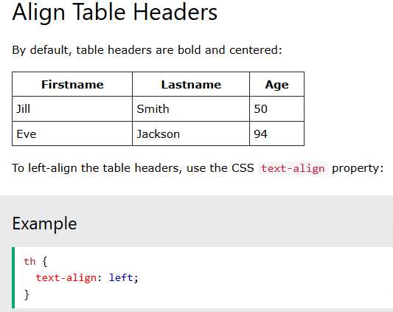
Align Table Headers
By default, table headers are bold and centered:
To left-align the table headers, use the CSS text-align property:
Example
th { text-align: left; }
Firstname | Lastname | Age
Jill | Smith | 50
Eve | Jackson | 94

Slide 157
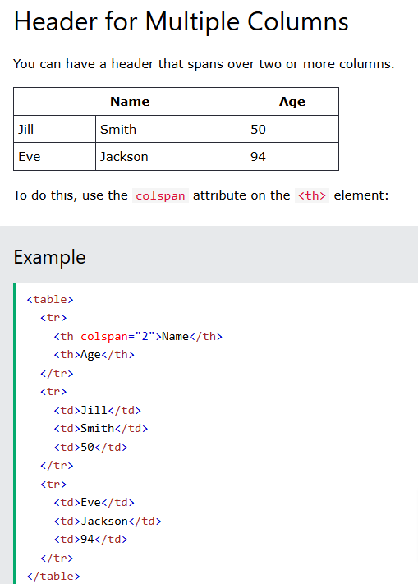
Header for Multiple Columns
You can have a header that spans over two or more columns.
To do this, use the colspan attribute on the <th> element:
Example
<table> <tr> <th colspan="2">Name</th> <th>Age</th> </tr> <tr> <td>Jill</td> <td>Smith</td> <td>50</td> </tr> <tr> <td>Eve</td> <td>Jackson</td> <td>94</td> </tr> </table>
Name |  | Age
Jill | Smith | 50
Eve | Jackson | 94

Slide 158


Slide 159


Slide 160
HTML Table - Cell Padding
Cell padding is the space between the cell edges and the cell content.
By default the padding is set to 0.
To add padding on table cells, use the CSS padding property:
Example
th, td { padding: 15px; }
Try it Yourself »
To add padding only above the content, use the padding-top property.
And the others sides with the padding-bottom, padding-left, and padding-right properties:
Example
th, td { padding-top: 10px; padding-bottom: 20px; padding-left: 30px; padding-right: 40px; }
Try it Yourself »
HTML Table - Cell Padding
Cell padding is the space between the cell edges and the cell content.
By default the padding is set to 0.
To add padding on table cells, use the CSS padding property:
Example
th, td { padding: 15px; }
Try it Yourself »
To add padding only above the content, use the padding-top property.
And the others sides with the padding-bottom, padding-left, and padding-right properties:
Example
th, td { padding-top: 10px; padding-bottom: 20px; padding-left: 30px; padding-right: 40px; }
Try it Yourself »

Slide 161


Slide 162
Rowspan and Colspan

Slide 163


Slide 164


Slide 165


Slide 166


Slide 167


Slide 168

HTML Table Colgroup

Slide 169


Slide 170


Slide 171
Unordered HTML List
An unordered list starts with the <ul> tag. Each list item starts with the <li> tag.
The list items will be marked with bullets (small black circles) by default:
Example
<ul> <li>Coffee</li> <li>Tea</li> <li>Milk</li> </ul>

Slide 172
Ordered HTML List
An ordered list starts with the <ol> tag. Each list item starts with the <li> tag.
The list items will be marked with numbers by default:
Example
<ol> <li>Coffee</li> <li>Tea</li> <li>Milk</li> </ol>

Slide 173
HTML Description Lists
HTML also supports description lists.
A description list is a list of terms, with a description of each term.
The <dl> tag defines the description list, the <dt> tag defines the term (name), and the <dd> tag describes each term:
Example
<dl> <dt>Coffee</dt> <dd>- black hot drink</dd> <dt>Milk</dt> <dd>- white cold drink</dd> </dl>

Slide 174


Slide 175
HTML List Tags
Tag | Description
<ul> | Defines an unordered list
<ol> | Defines an ordered list
<li> | Defines a list item
<dl> | Defines a description list
<dt> | Defines a term in a description list
<dd> | Describes the term in a description list

Slide 177
HTML Block and Inline Elements
❮ PreviousNext ❯
Every HTML element has a default display value, depending on what type of element it is.
The two most common display values are block and inline.

Slide 178

Block-level Elements
A block-level element always starts on a new line, and the browsers automatically add some space (a margin) before and after the element.
A block-level element always takes up the full width available (stretches out to the left and right as far as it can).
Two commonly used block elements are: <p> and <div>.
The <p> element defines a paragraph in an HTML document.
The <div> element defines a division or a section in an HTML document.
The <p> element is a block-level element.
The <div> element is a block-level element.
Example
<p>Hello World</p> <div>Hello World</div>
Try it Yourself »

Slide 179


Slide 180

Inline Elements
An inline element does not start on a new line.
An inline element only takes up as much width as necessary.
This is a <span> element inside a paragraph.
Example
<span>Hello World</span>
Try it Yourself »

Slide 181


Slide 182
The <div> Element
The <div> element is often used as a container for other HTML elements.
The <div> element has no required attributes, but style, class and id are common.
When used together with CSS, the <div> element can be used to style blocks of content:
Example
<div style="background-color:black;color:white;padding:20px;"> <h2>London</h2> <p>London is the capital city of England. It is the most populous city in the United Kingdom, with a metropolitan area of over 13 million inhabitants.</p> </div>

Slide 183
The <span> Element
The <span> element is an inline container used to mark up a part of a text, or a part of a document.
The <span> element has no required attributes, but style, class and id are common.
When used together with CSS, the <span> element can be used to style parts of the text:
Example
<p>My mother has <span style="color:blue;font-weight:bold;">blue</span> eyes and my father has <span style="color:darkolivegreen;font-weight:bold;">dark green</span> eyes.</p>
Try it Yourself »

Slide 184
Chapter Summary
A block-level element always starts on a new line and takes up the full width available
An inline element does not start on a new line and it only takes up as much width as necessary
The <div> element is a block-level and is often used as a container for other HTML elements
The <span> element is an inline container used to mark up a part of a text, or a part of a document

Slide 185
HTML Tags
Tag | Description
<div> | Defines a section in a document (block-level)
<span> | Defines a section in a document (inline)

Slide 186
https://www.w3schools.com/html/html_div.asp

Slide 187


Slide 188
<!DOCTYPE html> <html> <head> <style> #myHeader { background-color: lightblue; color: black; padding: 40px; text-align: center; } </style> </head> <body> <h1 id="myHeader">My Header</h1> </body> </html>

Slide 189


Slide 190


Slide 191

Multiple <div> elements
You can have many <div> containers on the same page.
Example
<div> <h2>London</h2> <p>London is the capital city of England.</p> <p>London has over 13 million inhabitants.</p> </div> <div> <h2>Oslo</h2> <p>Oslo is the capital city of Norway.</p> <p>Oslo has over 600.000 inhabitants.</p> </div> <div> <h2>Rome</h2> <p>Rome is the capital city of Italy.</p> <p>Rome has almost 3 million inhabitants.</p> </div>

Slide 193

Float
The CSS float property was not originally meant to align <div> elements side-by-side, but has been used for this purpose for many years.
The CSS float property is used for positioning and formatting content and allow elements float next to each other instead of on top of each other.
Example
How to use float to align div elements side by side:
<style> .mycontainer { width:100%; overflow:auto; } .mycontainer div { width:33%; float:left; } </style>

Slide 194

Inline-block
If you change the <div> element's display property from block to inline-block, the <div> elements will no longer add a line break before and after, and will be displayed side by side instead of on top of each other.
Example
How to use display: inline-block to align div elements side by side:
<style> div { width: 30%; display: inline-block; } </style>
Inline-block
If you change the <div> element's display property from block to inline-block, the <div> elements will no longer add a line break before and after, and will be displayed side by side instead of on top of each other.
Example
How to use display: inline-block to align div elements side by side:
<style> div { width: 30%; display: inline-block; } </style>

Slide 195

Flex
The CSS Flexbox Layout Module was introduced to make it easier to design flexible responsive layout structure without using float or positioning.
To make the CSS flex method work, surround the <div> elements with another <div> element and give it the status as a flex container.
Example
How to use flex to align div elements side by side:
<style> .mycontainer { display: flex; } .mycontainer > div { width:33%; } </style>
Flex
The CSS Flexbox Layout Module was introduced to make it easier to design flexible responsive layout structure without using float or positioning.
To make the CSS flex method work, surround the <div> elements with another <div> element and give it the status as a flex container.
Example
How to use flex to align div elements side by side:
<style> .mycontainer { display: flex; } .mycontainer > div { width:33%; } </style>

Slide 196

Grid
The CSS Grid Layout Module offers a grid-based layout system, with rows and columns, making it easier to design web pages without having to use floats and positioning.
Sounds almost the same as flex, but has the ability to define more than one row and position each row individually.
The CSS grid method requires that you surround the <div> elements with another <div> element and give the status as a grid container, and you must specify the width of each column.
Example
How to use grid to align <div> elements side by side:
<style> .grid-container { display: grid; grid-template-columns: 33% 33% 33%; } </style>

Slide 197
<div> | Defines a section in a document (block-level)

Slide 198

https://www.w3schools.com/html/html_classes.asp

Slide 199
https://www.w3schools.com/html/html_id.asp

Slide 200
HTML class Attribute
❮ PreviousNext ❯
The HTML class attribute is used to specify a class for an HTML element.
Multiple HTML elements can share the same class.

Slide 201
Using The class Attribute
The class attribute is often used to point to a class name in a style sheet. It can also be used by a JavaScript to access and manipulate elements with the specific class name.
In the following example we have three <div> elements with a class attribute with the value of "city". All of the three <div> elements will be styled equally according to the .city style definition in the head section:
Example
<!DOCTYPE html> <html> <head> <style> .city { background-color: tomato; color: white; border: 2px solid black; margin: 20px; padding: 20px; } </style> </head> <body> <div class="city"> <h2>London</h2> <p>London is the capital of England.</p> </div> <div class="city"> <h2>Paris</h2> <p>Paris is the capital of France.</p> </div> <div class="city"> <h2>Tokyo</h2> <p>Tokyo is the capital of Japan.</p> </div> </body> </html>

Slide 202
In the following example we have two <span> elements with a class attribute with the value of "note". Both <span> elements will be styled equally according to the .note style definition in the head section:
Example
<!DOCTYPE html> <html> <head> <style> .note { font-size: 120%; color: red; } </style> </head> <body> <h1>My <span class="note">Important</span> Heading</h1> <p>This is some <span class="note">important</span> text.</p> </body> </html>

Slide 203
Tip: The class attribute can be used on any HTML element.
Note: The class name is case sensitive!
Tip: You can learn much more about CSS in our CSS Tutorial.

Slide 204
The Syntax For Class
To create a class; write a period (.) character, followed by a class name. Then, define the CSS properties within curly braces {}:
Example
Create a class named "city":
<!DOCTYPE html> <html> <head> <style> .city { background-color: tomato; color: white; padding: 10px; } </style> </head> <body> <h2 class="city">London</h2> <p>London is the capital of England.</p> <h2 class="city">Paris</h2> <p>Paris is the capital of France.</p> <h2 class="city">Tokyo</h2> <p>Tokyo is the capital of Japan.</p> </body> </html>
Try it Yourself »

Slide 205
Multiple Classes
HTML elements can belong to more than one class.
To define multiple classes, separate the class names with a space, e.g. <div class="city main">. The element will be styled according to all the classes specified.
In the following example, the first <h2> element belongs to both the city class and also to the main class, and will get the CSS styles from both of the classes:
Example
<h2 class="city main">London</h2> <h2 class="city">Paris</h2> <h2 class="city">Tokyo</h2>

Slide 206
Different Elements Can Share Same Class
Different HTML elements can point to the same class name.
In the following example, both <h2> and <p> point to the "city" class and will share the same style:
Example
<h2 class="city">Paris</h2> <p class="city">Paris is the capital of France</p>
Try it Yourself »

Slide 207
Use of The class Attribute in JavaScript
The class name can also be used by JavaScript to perform certain tasks for specific elements.
JavaScript can access elements with a specific class name with the getElementsByClassName() method:
Example
Click on a button to hide all elements with the class name "city":
<script> function myFunction() { var x = document.getElementsByClassName("city"); for (var i = 0; i < x.length; i++) { x[i].style.display = "none"; } } </script>

Slide 208
Don't worry if you don't understand the code in the example above.
You will learn more about JavaScript in our HTML JavaScript chapter, or you can study our JavaScript Tutorial.
Chapter Summary
The HTML class attribute specifies one or more class names for an element
Classes are used by CSS and JavaScript to select and access specific elements
The class attribute can be used on any HTML element
The class name is case sensitive
Different HTML elements can point to the same class name
JavaScript can access elements with a specific class name with the getElementsByClassName() method

Slide 209


Slide 210
Example
<!DOCTYPE html> <html> <head> <style> #myHeader { background-color: lightblue; color: black; padding: 40px; text-align: center; } </style> </head> <body> <h1 id="myHeader">My Header</h1> </body> </html>

Slide 211
Difference Between Class and ID
A class name can be used by multiple HTML elements, while an id name must only be used by one HTML element within the page:

Slide 212
<style> /* Style the element with the id "myHeader" */ #myHeader { background-color: lightblue; color: black; padding: 40px; text-align: center; } /* Style all elements with the class name "city" */ .city { background-color: tomato; color: white; padding: 10px; } </style> <!-- An element with a unique id --> <h1 id="myHeader">My Cities</h1> <!-- Multiple elements with same class --> <h2 class="city">London</h2> <p>London is the capital of England.</p> <h2 class="city">Paris</h2> <p>Paris is the capital of France.</p> <h2 class="city">Tokyo</h2> <p>Tokyo is the capital of Japan.</p>

Slide 213
Example
First, create a bookmark with the id attribute:
<h2 id="C4">Chapter 4</h2>
Then, add a link to the bookmark ("Jump to Chapter 4"), from within the same page:
Example
<a href="#C4">Jump to Chapter 4</a>

Slide 214
Or, add a link to the bookmark ("Jump to Chapter 4"), from another page:
<a href="html_demo.html#C4">Jump to Chapter 4</a>

Slide 215
Using The id Attribute in JavaScript
The id attribute can also be used by JavaScript to perform some tasks for that specific element.
JavaScript can access an element with a specific id with the getElementById() method:
Example
Use the id attribute to manipulate text with JavaScript:
<script> function displayResult() { document.getElementById("myHeader").innerHTML = "Have a nice day!"; } </script>
Try it Yourself »
Tip: Study JavaScript in the HTML JavaScript chapter, or in our JavaScript Tutorial.

Slide 216
Chapter Summary
The id attribute is used to specify a unique id for an HTML element
The value of the id attribute must be unique within the HTML document
The id attribute is used by CSS and JavaScript to style/select a specific element
The value of the id attribute is case sensitive
The id attribute is also used to create HTML bookmarks
JavaScript can access an element with a specific id with the getElementById() method

